Slide 1
Set up a Search Alert & Collection with the Lens
Paul Oldham

Slide 2
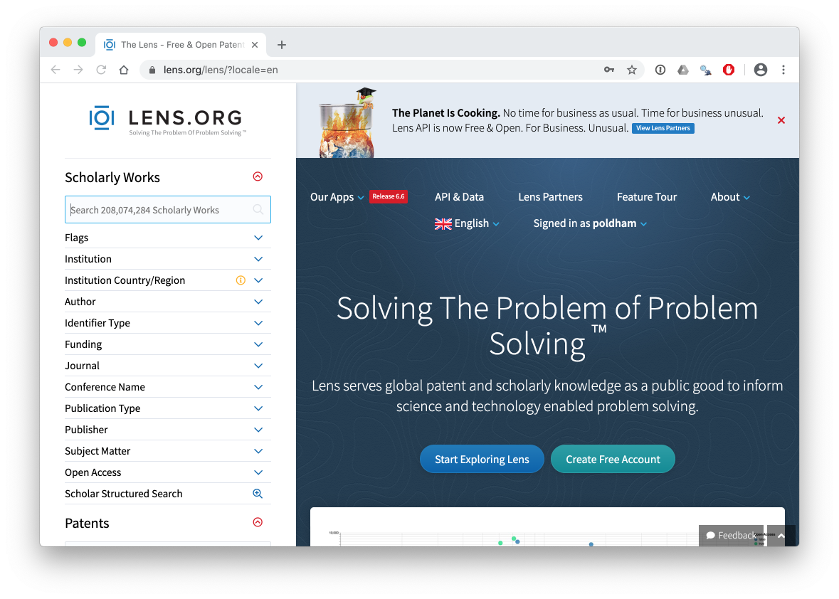
Go to lens.org and sign up for a free account

Slide 3
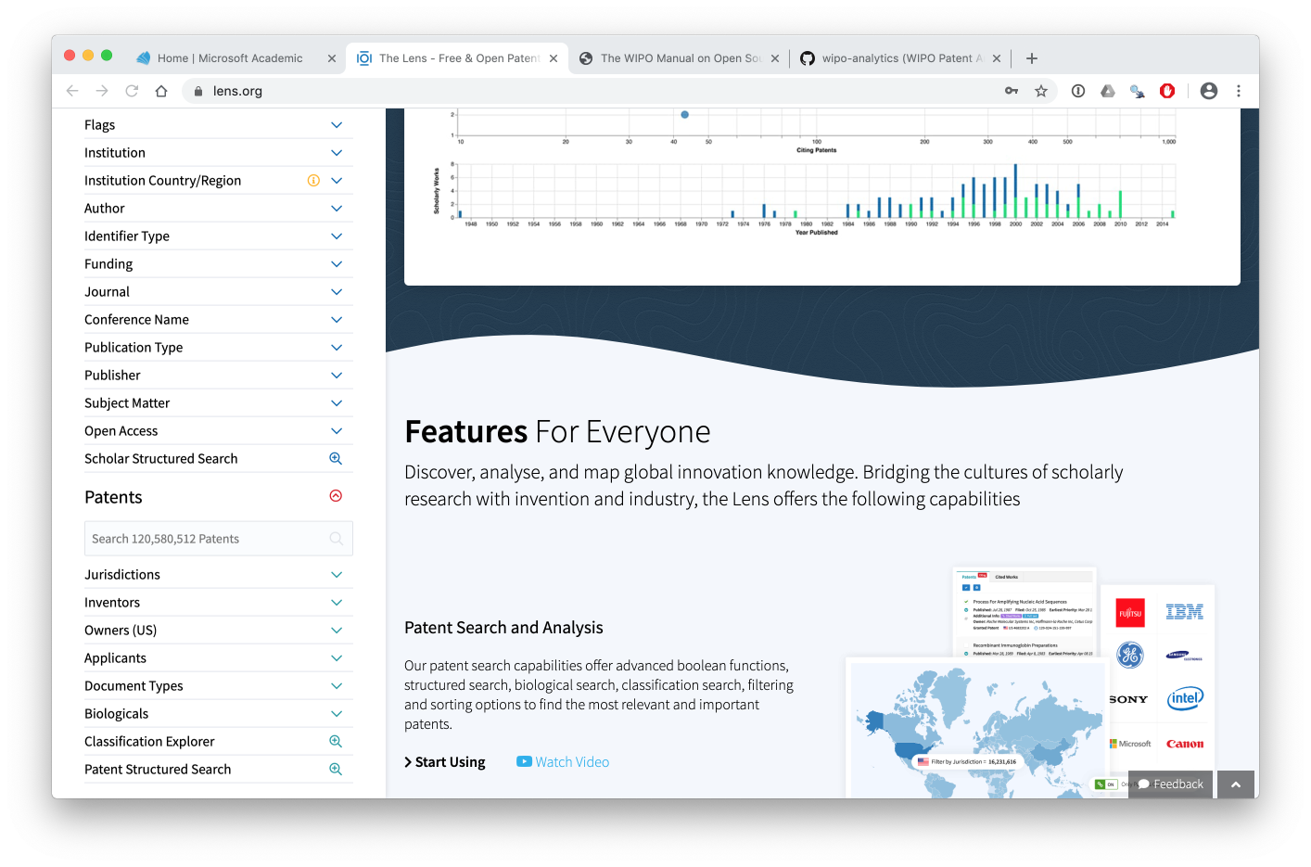
Go to the bottom of the page

Slide 4
Copy the patent query for Kenya at the bottom of the ‘biodiversity_query’ in the helpers folder of your pen drive or online here

Slide 5
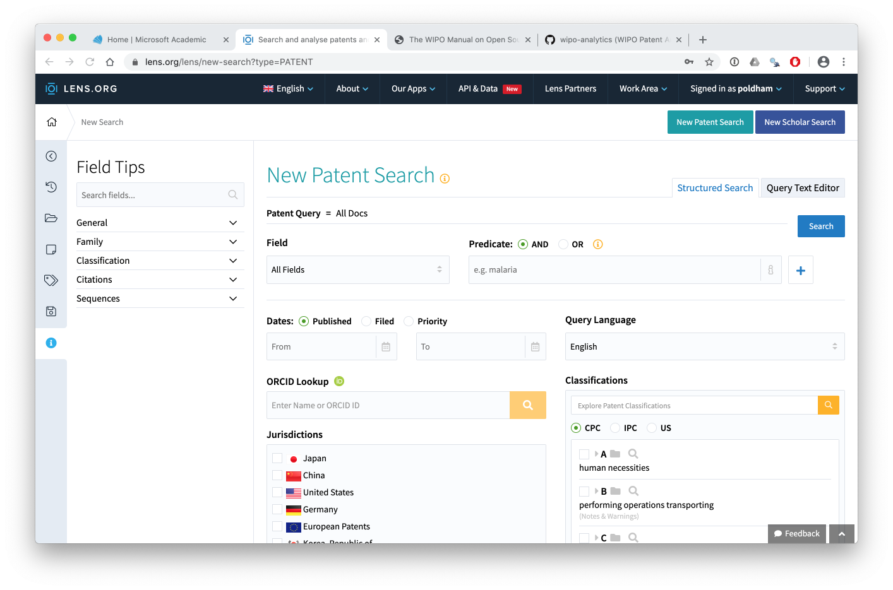

Slide 8
Create an email alert by saving a query

Slide 9
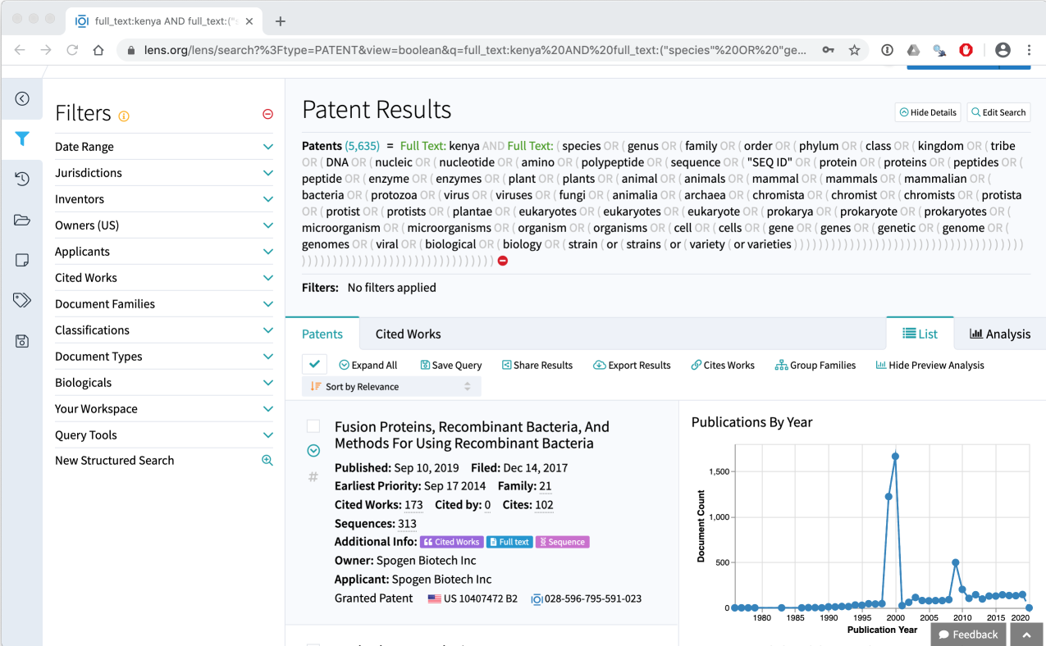
Save A Query for Email Alerts

Slide 10
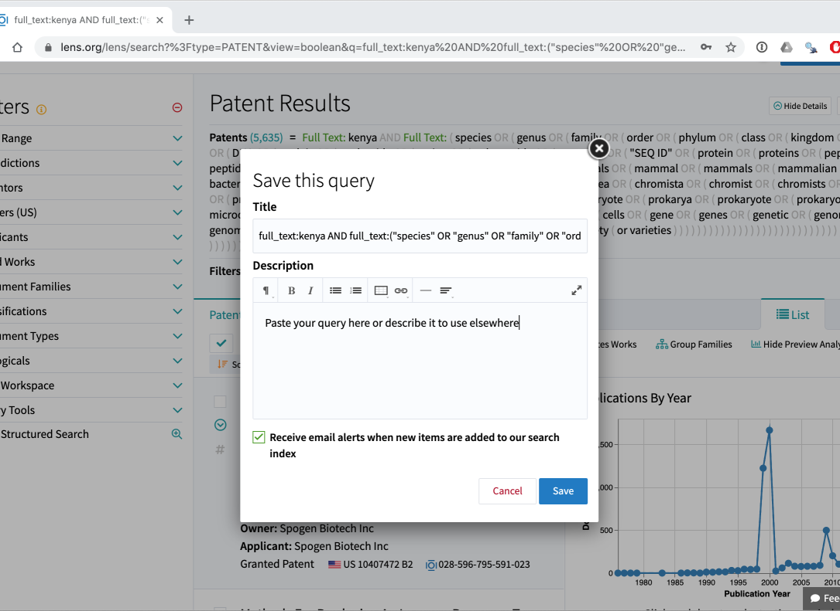
Save a Query: If it Doesn’t seem to save try shortening the title.

Slide 11
Create, Share and Export a Collection

Slide 12
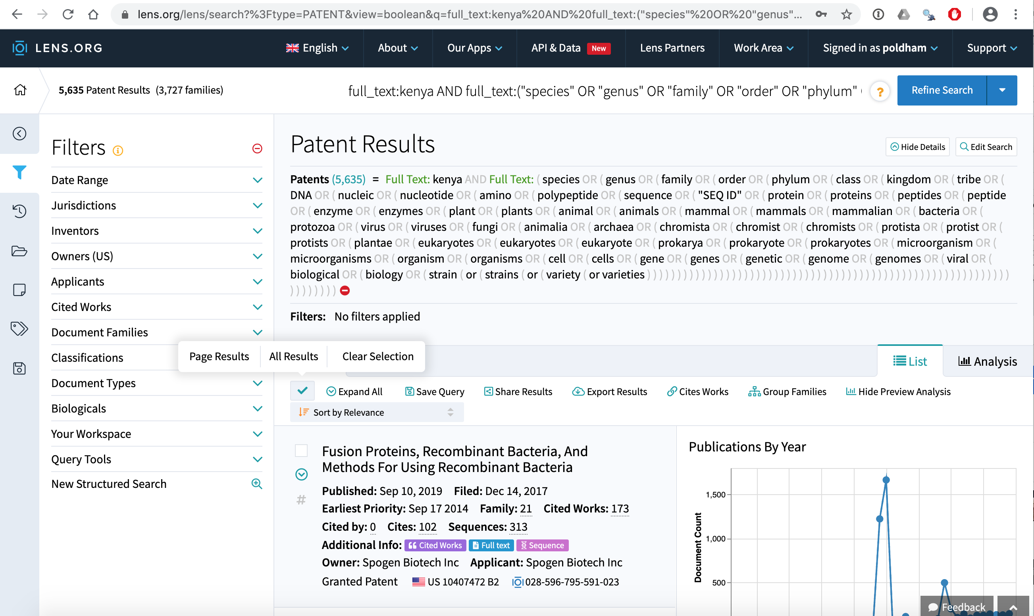
Select the Green Tick Next to Expand All and the All Results

Slide 13
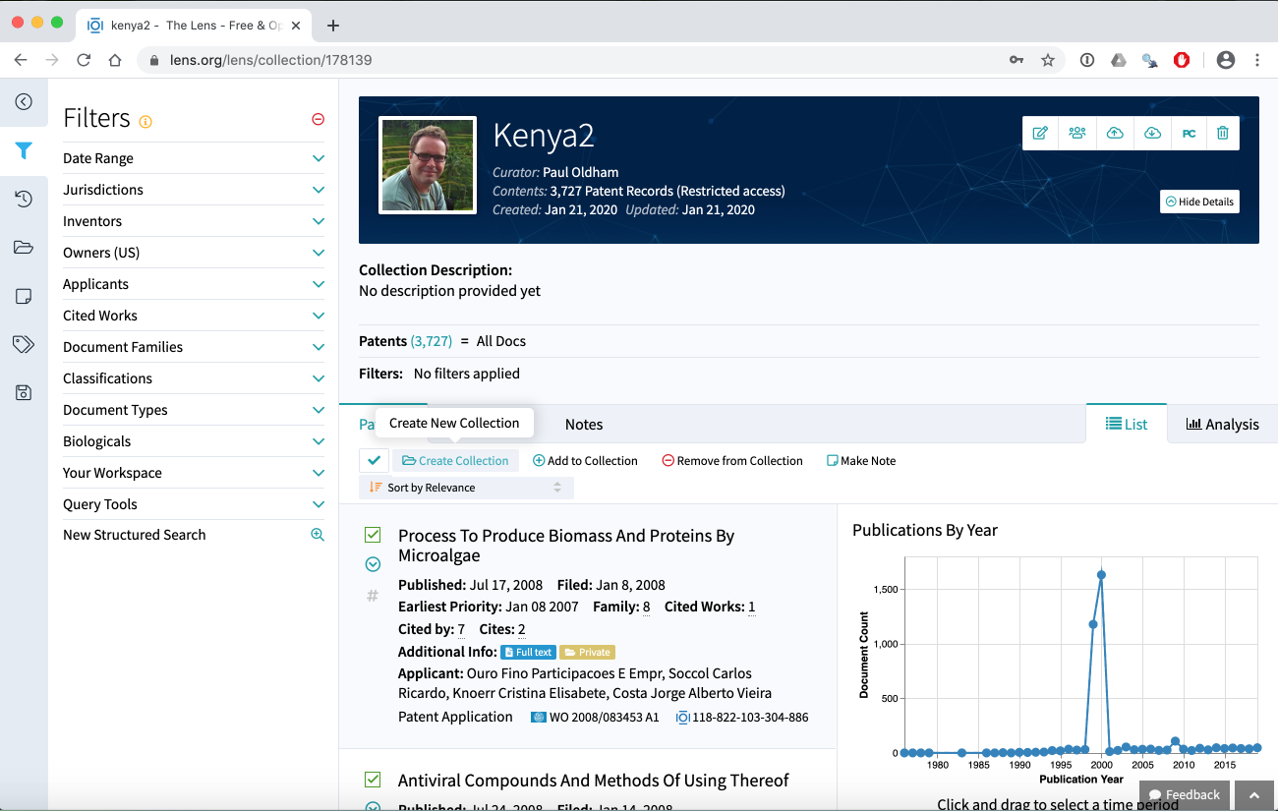

Slide 15
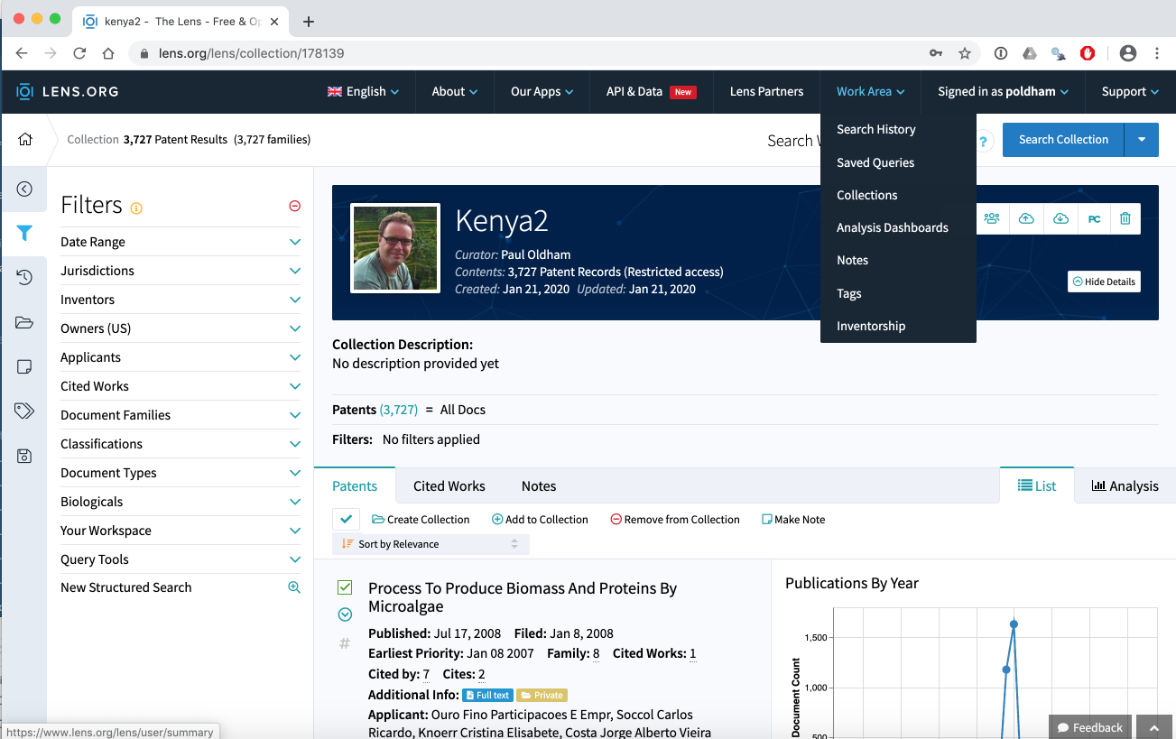

Slide 16
Share a Collection

Slide 17
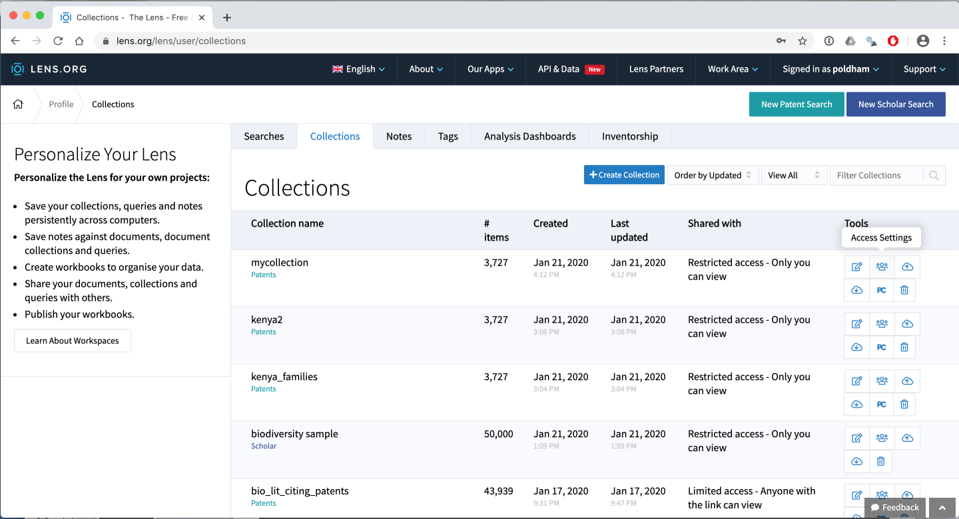
How to Share A Document

Slide 18
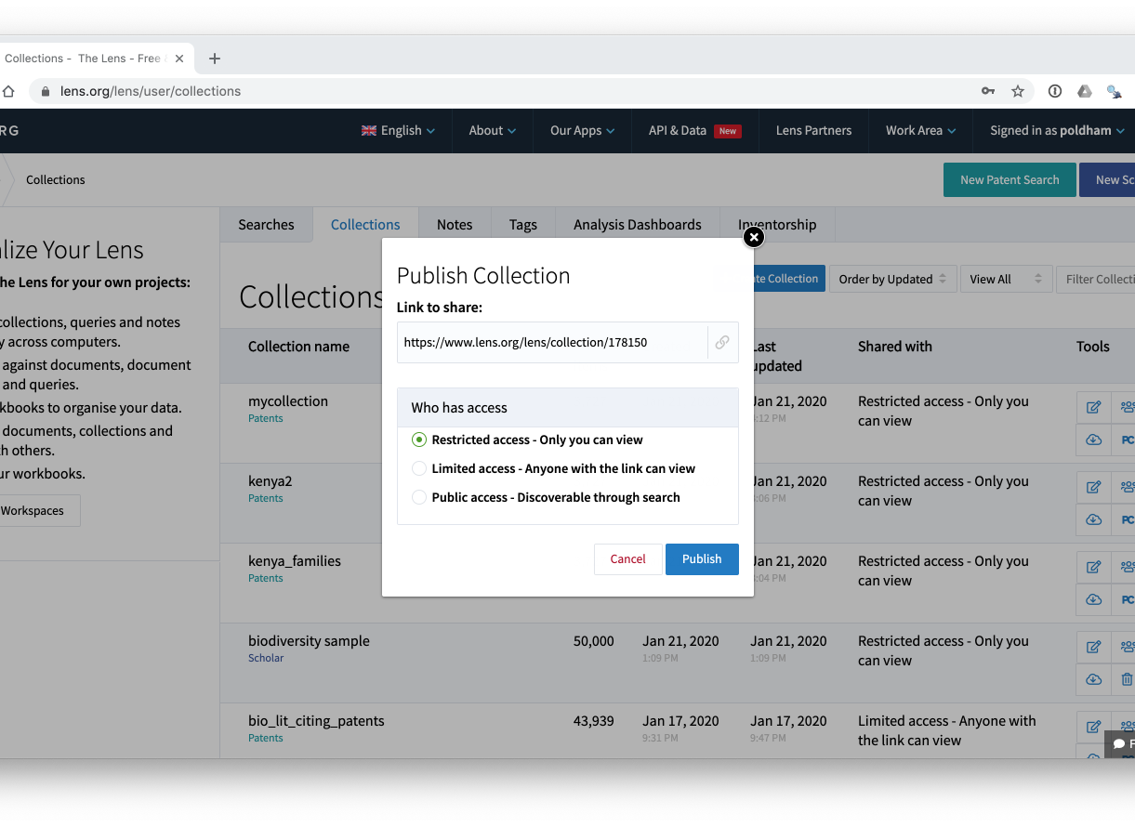

Slide 19
Export a Collection

Slide 20
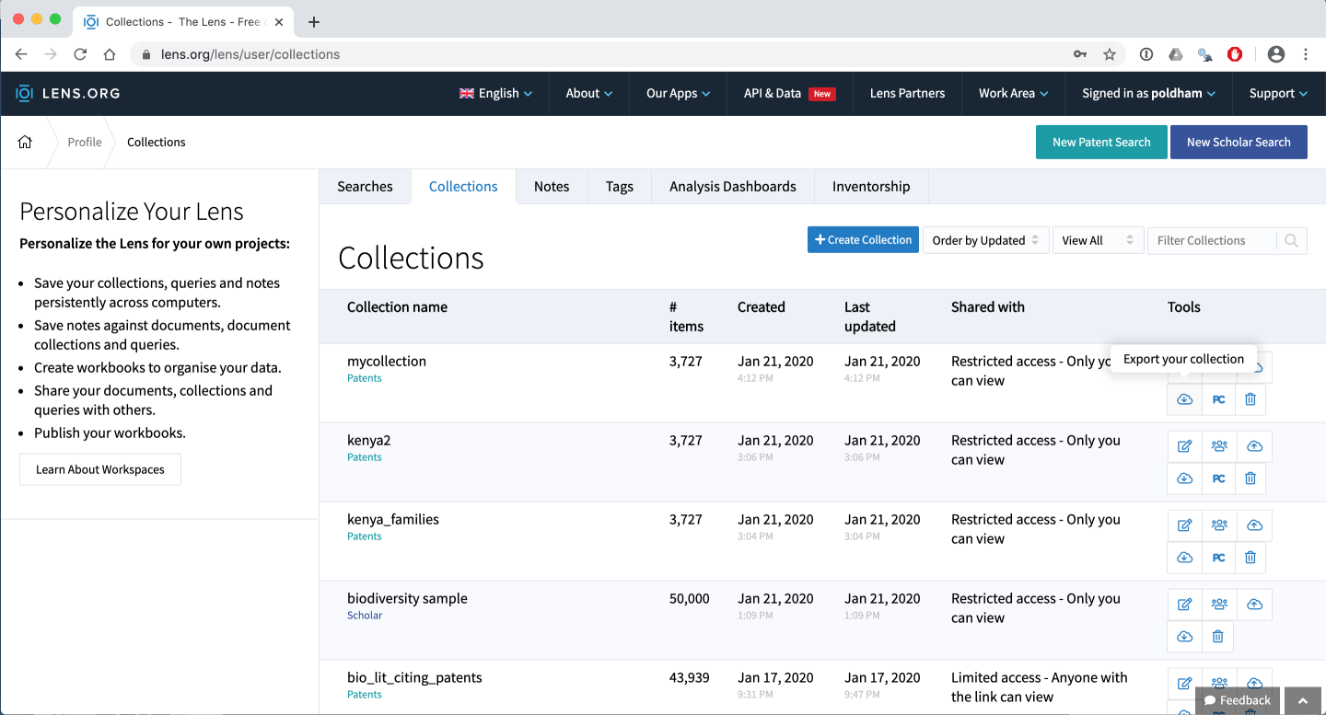

Slide 21
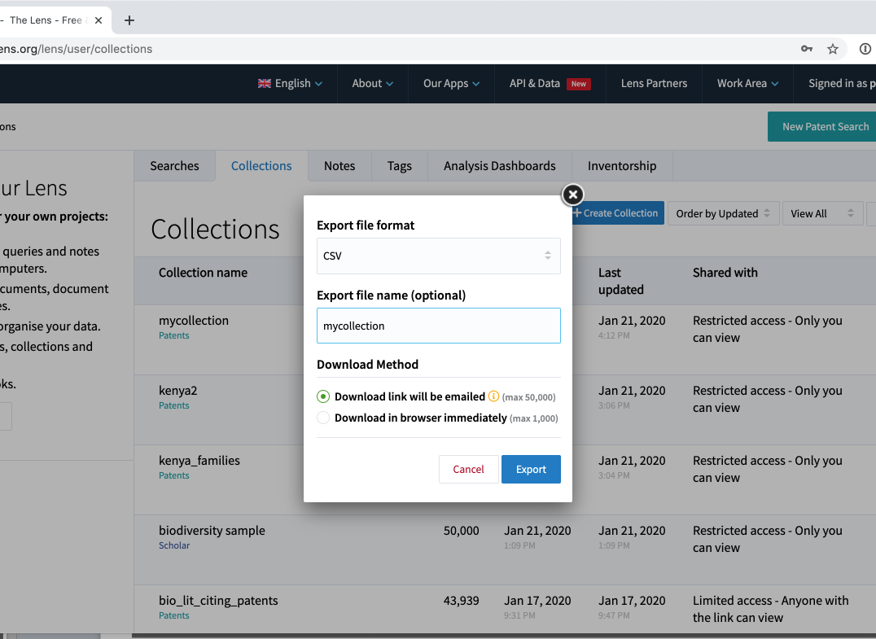
Note the difference in size of the two options

Slide 22
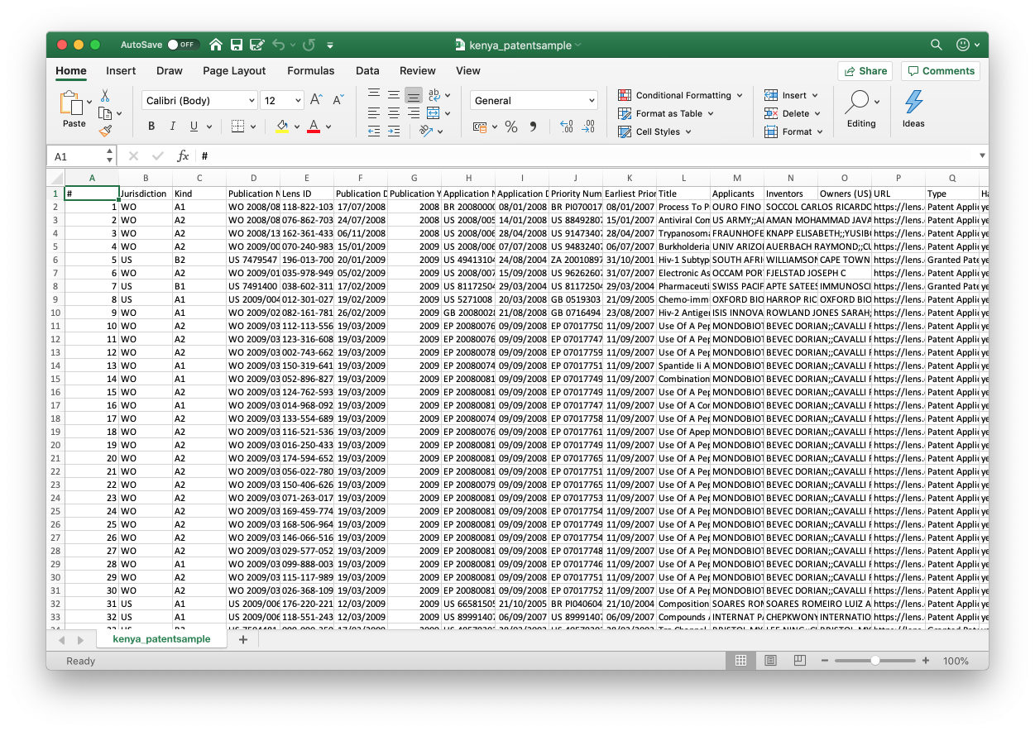
View the Data
Read the Open access WIPO Manual on Open Source Patent Analytics to learn to process patent data

